Slide 1

a/b testing
M ABHINAV

Slide 2
hypothesis
There are two categories of customers specified by the customer type, Member or Normal customer
From the dataset, we want to draw a conclusion about the purchase made by the normal customers. That is if the average total is less than that of members.
Null Hypothesis : Both the members' and normal customers' average total are same and not much different.
Alternate Hypothesis: The average total of the normal customers is less than the members..

Slide 3
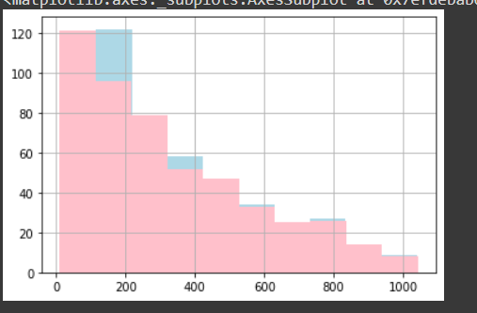
Normal: light blue member: pink

Slide 4
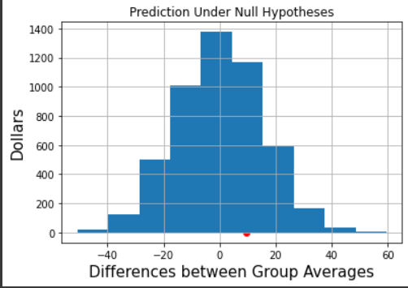
Analysis
The test statistic is the difference in the average total.
The observed test statistic is 9.6684.
When a random sample is simulated using permutation the differences observed are plotted along with the observed difference.

Slide 5
Conclusion
As the difference is less than that of many samples generated ,the Null hypothesis is not rejected.
The empirical P value is 0.7352 greater than the significance level, hence it too supports the Null hypothesis.
Hence, we can conclude that the average total by both the customers come from the same distribution.

